Slide 1
Digital Portfolio
STUDENT NAME: DEVIPRIYA. B
REGISTER NO AND NMID:2422K0912 /B238707D935697D89094151A833A64EB
DEPARTMENT:COMPUTER SCIENCE
COLLEGE:TIRUPPUR KUMARAN COLLEGE FOR WOMEN./Bharathiyar University

Slide 2
PROJECT TITLE
My portfolio is gynecologist

Slide 3


AGENDA
Problem Statement
Project Overview
End Users
Tools and Technologies
Portfolio design and Layout
Features and Functionality
Results and Screenshots
Conclusion
Github Link
3/21/2024 Annual Review

Slide 4

PROBLEM STATEMENT
Present the doctor’s qualifications, services, and contact information clearly.Increase appointment inquiries by X% within 3 months (set target).Provide trust signals (certifications, testimonials, publications).Mobile page load under 2.5s and Lighthouse accessibility score ≥ 90.Easy content update workflow for the doctor/staff.

Slide 5

PROJECT OVERVIEW
Frontend: HTML, CSS, JavaScript (React/Next.js optional).Backend (if needed): Node.js / PHP for form handling.Hosting: Netlify, Vercel, or similar.Database (optional): MySQL / MongoDB (if booking system needed).Third-party Integrations: Google Maps, Formspree/Netlify Forms for contact, optional booking API.

Slide 6

WHO ARE THE END USERS?
1. Prospective Patients – To know services, qualifications, and book appointments.2. Existing Patients – For follow-ups, resources, clinic details, and bookings.3. Caregivers/Family – To find trusted doctors and clinic info.4. Other Doctors – To check expertise for referrals.5. Students/Researchers – To view publications or research.6. General Public – For health tips, awareness articles, and events.

Slide 7

TOOLS AND TECHNIQUES
HTML, CSS, JavaScript – Website development.Figma/Canva – UI/UX design.MySQL / MongoDB – For appointment data (if needed).Responsive Design & SEO – Mobile-friendly + search visibility.Security & Accessibility – HTTPS, user-friendly navigation

Slide 8
POTFOLIO DESIGN AND LAYOUT
1. Header – Name, title, photo, tagline.2. Navbar – Home | About | Services | Achievements | Contact.3. Hero Section – Banner + “Book Appointment” button.4. About – Bio, education, experience.5. Services – Care cards (Pregnancy, Infertility, Menstrual, Preventive).6. Achievements – Awards, publications, testimonials.7. Patient Resources – FAQs, health tips.8. Contact – Address, phone, email, appointment form.
8

Slide 9
FEATURES AND FUNCTIONALITY
Doctor Profile – About, education, specialization.2. Services Section – Pregnancy care, infertility, screenings, etc.3. Online Appointment Booking – Form with date & time selection.4. Patient Resources – FAQs, health tips, downloadable guides.5. Testimonials – Patient reviews & success stories.6. Contact & Location – Phone, email, Google Map integration.7. Responsive Design – Works on mobile, tablet, and desktop.8. Secure Data Handling – HTTPS, encrypted appointment

Slide 10
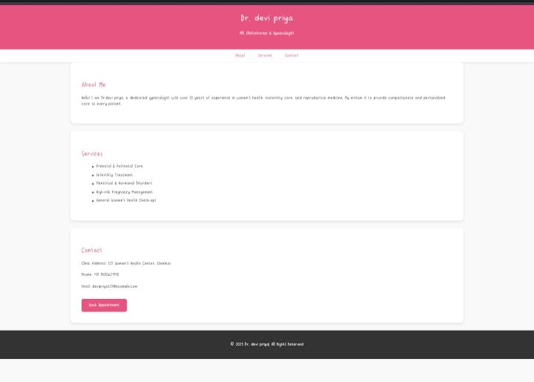

RESULTS AND SCREENSHOTS
3/21/2024 Annual Review
10

Slide 11
CONCLUSION
The gynecologist portfolio serves as a professional platform that highlights the doctor’s qualifications, services, and achievements. It provides patients with easy access to health information, appointment booking, and contact details. By combining a clean design with useful features, the portfolio builds trust, improves communication, and enhances the overall healthcare experience for women.
11

